Slide 1
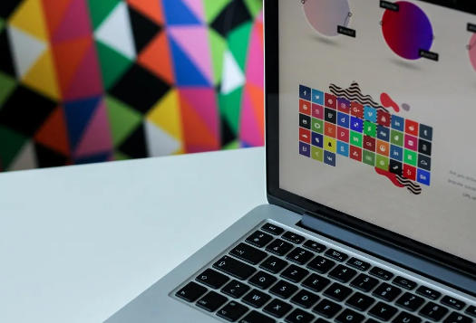
Computer Graphics
Lecture 1

Slide 2
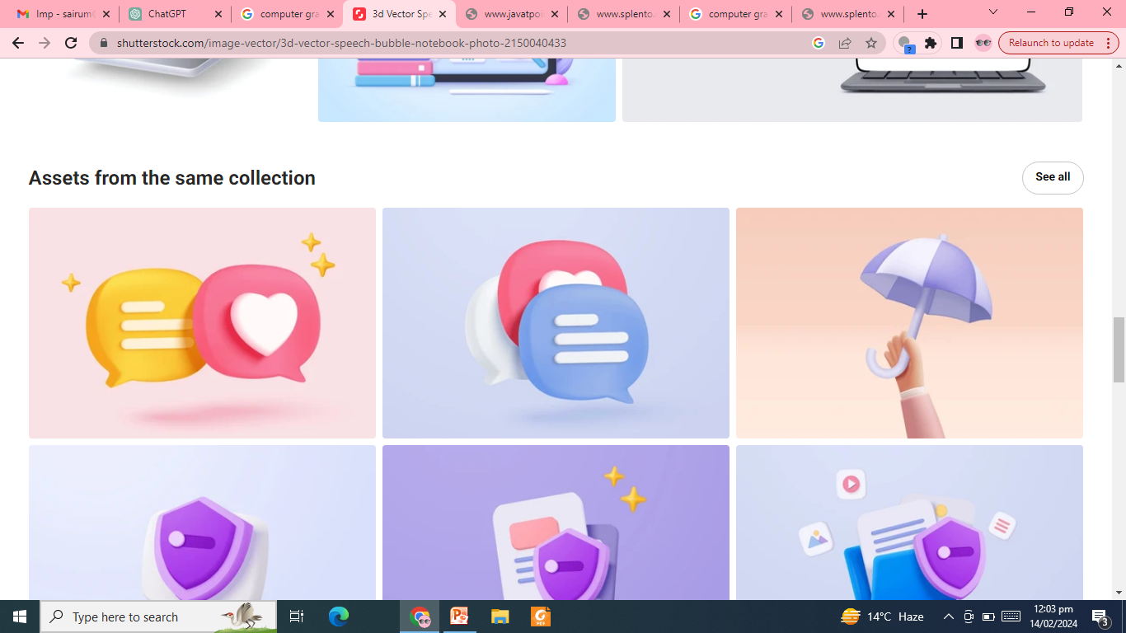
Introduction to CG
Computer graphics is the display, storage & manipulation of images and data for the visual representation of a system.
A typical graphics system consists of host computer, fast processor, large memory and frame buffer along with display devices, input devices, and output devices.
Notes:
It is the use of computers to create and manipulate pictures on a display device.
Graphics and visual computing is the field that deals with the display and control of images on a computer screen

Slide 3
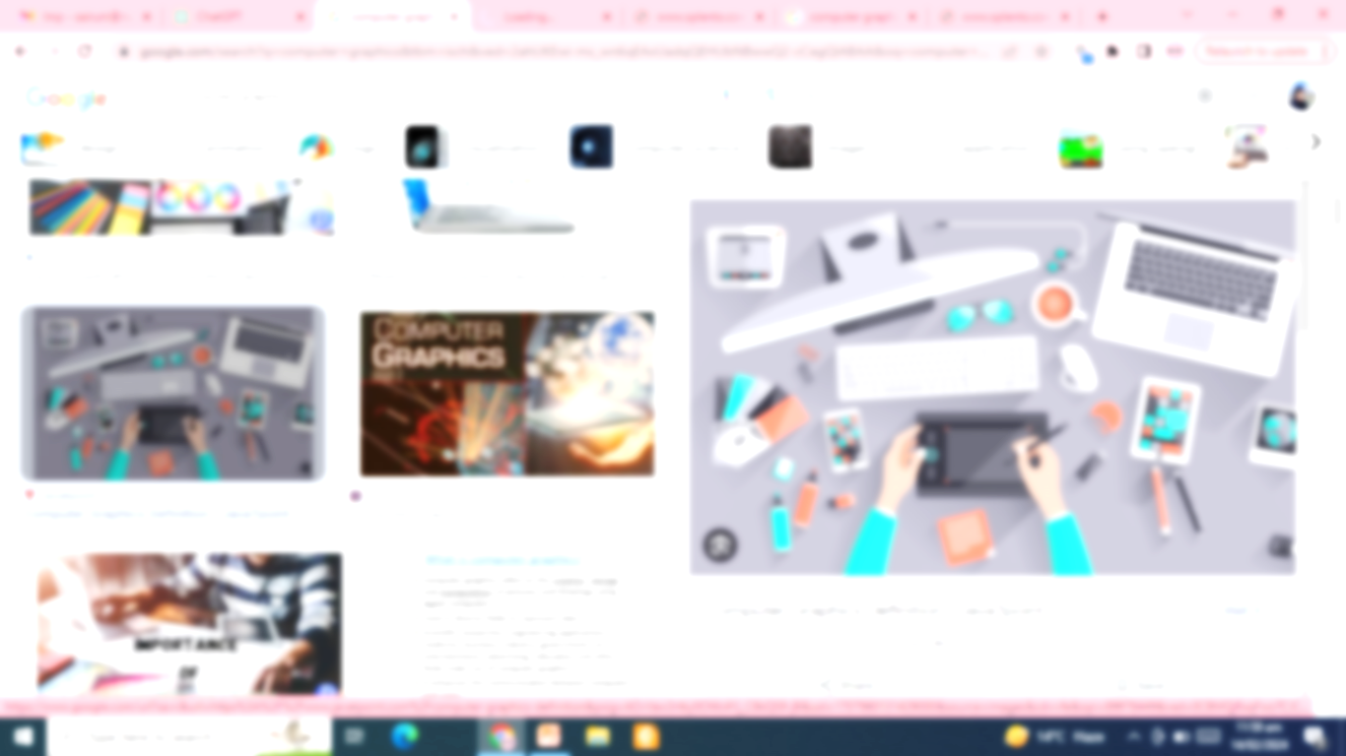
Computer Graphics
Computer graphics deals with all aspects of creating images with a computer
Hardware
Software
Applications

Slide 4
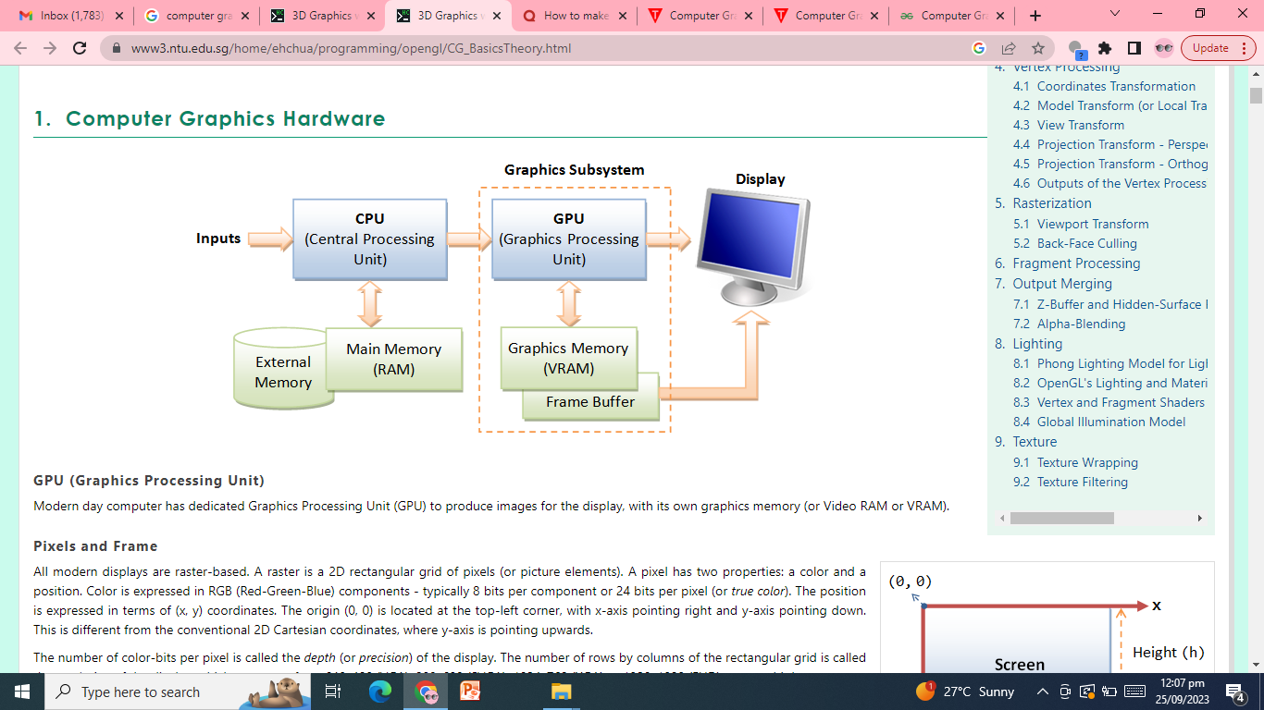

Slide 5
Computer Graphics
Computer graphics refers to the field of visual computing that involves creating, manipulating, and displaying images and animations using computers. It encompasses a wide range of techniques and technologies for generating and processing visual content, including:
2D Graphics: This involves creating and manipulating images in two-dimensional space. Techniques include drawing shapes, text, and images, as well as applying various transformations such as scaling, rotation, and translation.
3D Graphics: This involves creating and manipulating images in three-dimensional space. It includes techniques for creating and rendering three-dimensional objects, applying textures, lighting effects, and simulating realistic materials and environments.

Slide 6
Rendering: Rendering refers to the process of generating images from 3D models or scenes. It involves techniques such as rasterization, ray tracing, and radiosity to calculate the colors and intensities of pixels in the final image.
Animation: Animation involves creating the illusion of motion by displaying a sequence of images or frames in rapid succession. Techniques include keyframing, interpolation, and skeletal animation.
Visualization: This involves representing complex data in visual form to aid understanding and analysis. Techniques include scientific visualization, information visualization, and virtual reality.
Computer-Aided Design (CAD): CAD involves using computer graphics techniques to assist in the creation, modification, analysis, and optimization of designs for engineering, architecture, and other fields.
Computer graphics finds applications in various industries such as entertainment (movies, video games), design (architecture, product design), education (simulation, virtual laboratories), science (visualization of scientific data), and many others. It plays a crucial role in modern digital media and has significantly influenced the way we interact with computers and digital devices

Slide 7
Use of Computer Designed Pictures
Art, Entertainment and publishing
Movie production, Animation and special effects
Computer Games
Browsing on world wide web
Paint System
Monitoring a process
Displaying simulations
Computer aided designs

Slide 8
Computer Graphics & Image Processing
Computer Graphics->
create pictures and images
Synthesize(create) them on basis of some description(Model )
Image Processing->
Improve or alter the images
Processing can remove noise or enhance contrast
Enhance certain features.

Slide 9
Applications of Computer Graphics
GUI
Scientific Visualization
Entertainment
Architectural scenes
Medicine
Virtual world
Education

Slide 10
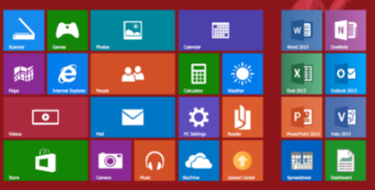
GUI
Menus, icons, cursors, dialog boxes, scrollbars, grids, 3d interface

Slide 11
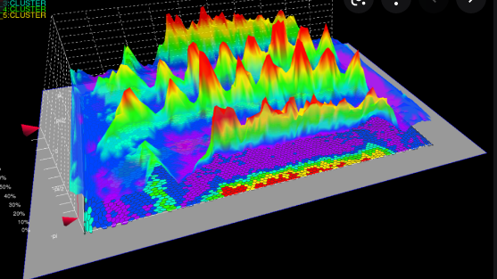
Scientific Visualization
Also known as SciVis, is the representation of data graphically as a means of gaining understanding and insight into the data.
Also known as visual data analysis. This allows the researcher to gain insight into the system that is studied in ways previously impossible.
What it is not- It is important to differentiate between scientific visualization and presentation graphics.
Presentation graphics is primarily concerned with the communication of information and results in ways that are easily understood.
Scientific visualization, we seek to understand the data. However, often the two methods are intertwined.
Notes:
visualization of scientific phenomena.

Slide 12
From a computing perspective, SciVis is part of a greater field called visualization.
This involves research in computer graphics, image processing, high performance computing, and other areas. The same tools that are used for SciVis may be applied to animation, or multimedia presentation, for example.
As a science, scientific visualization is the study concerned with the interactive display and analysis of data.
Often one would like the ability to do real-time visualization of data from any source. Thus our preview is information, scientific, or engineering visualization and closely related problems such as computational steering or multivariate analysis. The approaches developed are general, and the goal is to make them applicable to datasets of any size whatever, while still retaining high interactivity. As an emerging science, its strategy is to develop fundamental ideas leading to general tools for real applications. This search is multidisciplinary in that it uses the same techniques across many areas of study.

Slide 13
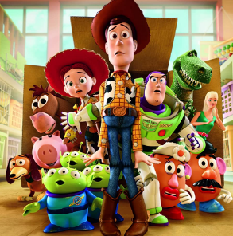
Entertainment
One of the main fields of application of computer graphics is the entertainment industry, in particular computer games and movies.
First film, which began to use computer graphics, was the Throne
First feature-length film created completely using computer was Toy Story.

Slide 14
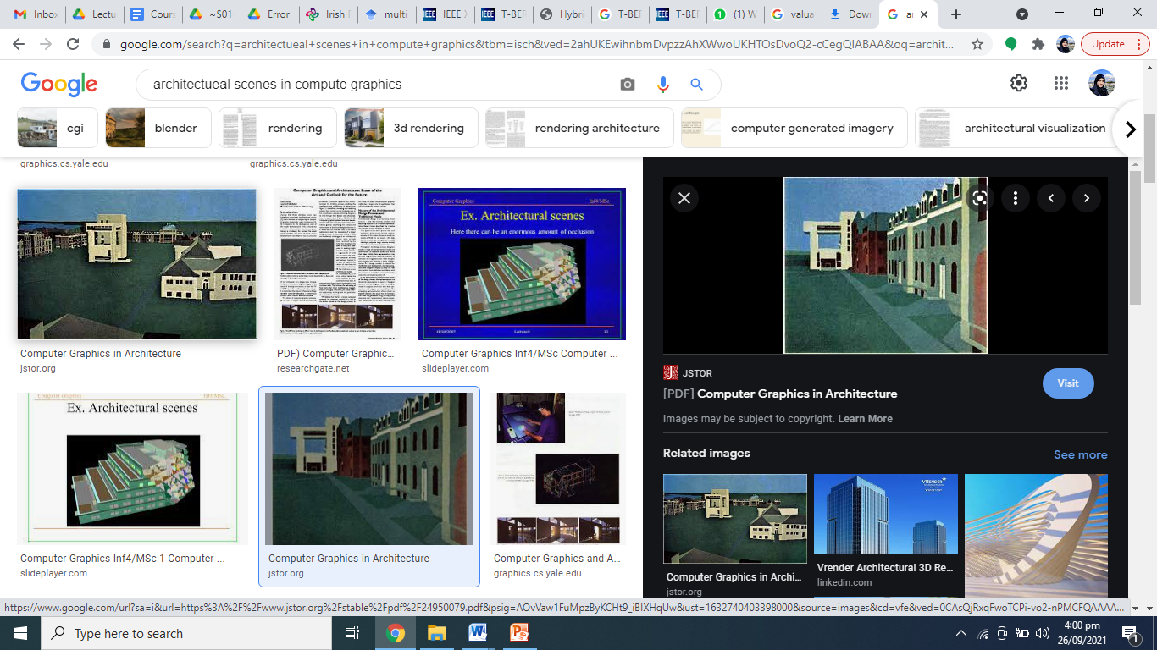
Architectural scenes:
Modern architects use 3-dimensional models for both customers and builders
More accurate computer generated models
Architectural animations are used in :
Showing relationship of a building, environment and its surrounding buildings
rendering architectural spaces without the use of paper and pencil tools
creation of interactive environments to visualize the system before it is created
computer-generated images are used to "reverse engineer" historical buildings
Notes:
For instance, a computer-generated reconstruction of the monastery at Georgenthal in Germany was derived from the ruins of the monastery; it provides the viewer with a "look and feel" of what the building would have looked like in its day.

Slide 15
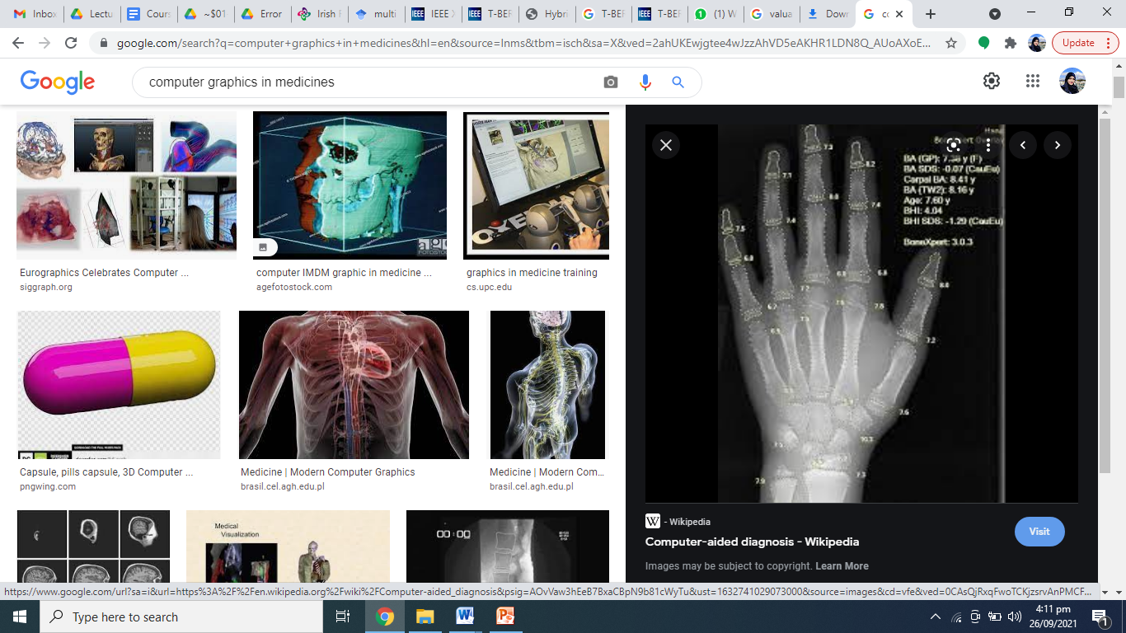
Medicine
Computer graphics is used in medical diagnosis as it provides:
ability to visualize measure and evaluate structures in a non-interfering manner.
Is used in training and provide new methods for learning, as professionals can test their skills in simulators and evaluate their performance in a virtual environment
More accurate and better than traditional training that involves great number of dissections in order to correctly learn about the human anatomy/ structure
provide 3D models that allows the professional not only to use a 3D model as a biography plans but also interact with it to perform surgery rehearsals

Slide 16
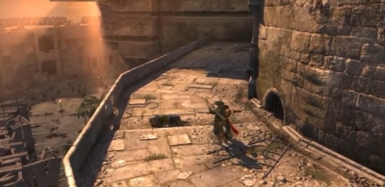
Virtual worlds
Gaming environments, ‘Prince of Persia’ had Turkey’s streets in it.

Slide 17
Education
Computer Graphics leads to introduce new computer-based programs and applications, for teaching specific concepts included in the school curriculum.
The application of new technologies is starting to produce good results in the education and intervention process.
Useful applications for teaching and training specific concepts (such as academic, social or communicative skills) seems to be of interest to all associations and special schools
Other areas where CG is being actively applied are courtrooms, Supermarkets, Apparel stores, Vehicle’s navigation etc.

Slide 18
Elements of pictures created in computer graphics include
Pixels: Individual picture elements forming the image.
Color: Representation of hues and tones within the image.
Shapes and Objects: Defined geometric forms and entities.
Textures: Surface detail simulating real-world materials.
Lighting: Illumination affecting the appearance of objects.
Rendering Techniques: Methods for converting models into images.
Composition: Arrangement of elements within the image.
Effects: Enhancements applied for visual impact.
Resolution: Level of detail and clarity in the image.
Interactivity (optional): Ability for users to manipulate elements in real-time.

Slide 19
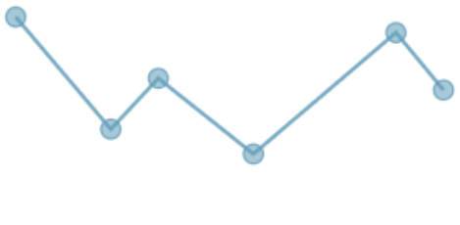
Elements of pictures Created in Computer Graphics
Basic objects are
Poly line
Text
Filled regions
Raster images

Slide 20
Elements of pictures Created in Computer Graphics
Poly Lines
Connected sequence of straight lines
Line Drawings Pictures made up of poly lines
If several lines in polyline the each line is called an edge
Two adjacent lines meet at vertex
Polygon:
A polyline is closed if it ends where it starts called polygon
It is simple if it does not self-intersect
Simple polygon(Jordan polygons)
Well-defined two regions(inside and out side)
Notes:
Poly means many
Gon means angles
Convex Polygons: In a convex polygon, any line segment joining any two inside points lies inside the polygon.

Slide 21
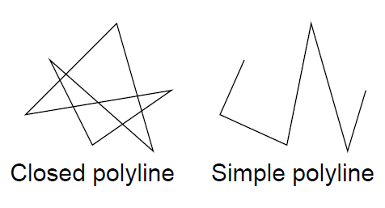
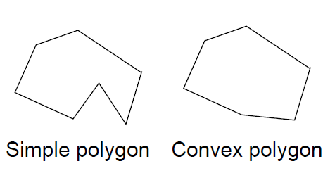
Notes:
Simple polygon In a concave polygon, a line segment connecting any two points may or may not lie inside the polygon.

Slide 22
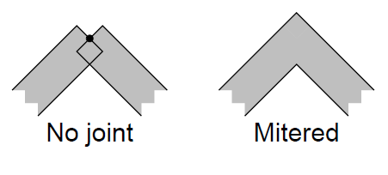
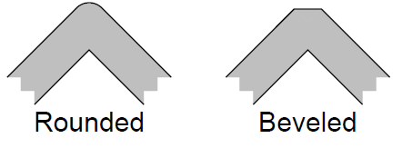
Attributes of Lines & Poly Lines
Color
Thickness
Type( dashed, solid, dotted)
Manner in which thick edges are blend

Slide 23
Filled Region
Shape filled with some color or pattern.
Boundary of filled shape is a polygon
Attributes
Enclosing border
Pattern
color

Slide 24
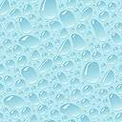

Slide 25
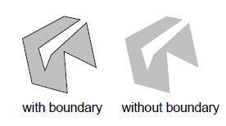
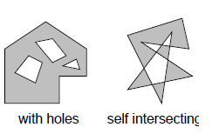

Slide 26
Text
Text can be thought of as a sequence of characters in some font.
Some Graphic devices has two modes
Text Mode:
Use for simple input & out put Characters to control operating system or edit code in program
Built in character generator
Capable of drawing Alphabets, Numeric & special characters
Graphic Mode:
Richer set of character shapes
Characters can be placed arbitrarily
Notes:
A way of using a computer display such that the basic unit is the character cell – the space taken up by a single character.
The only images that can be displayed are those that can be built from character-sized blocks;
surprisingly complex images can however be built in text mode.

Slide 27
Raster Images
Image is made up of many cells, in different shades.
Each cell is known as pixel.
Stored in memory as 2-dimensional array of square/ rectangle cells
pixel maps/bitmap

Slide 28
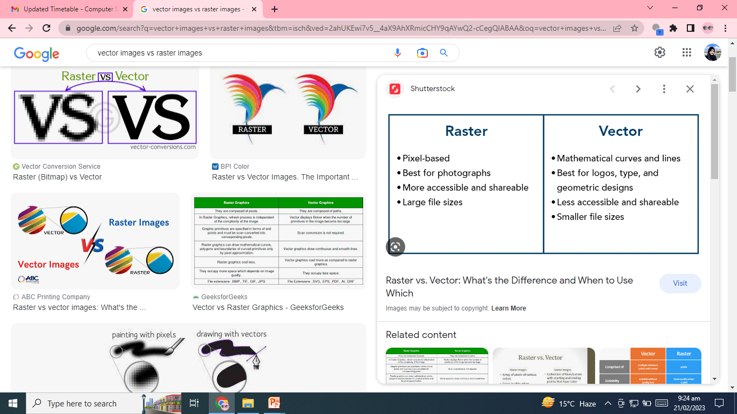

Slide 29
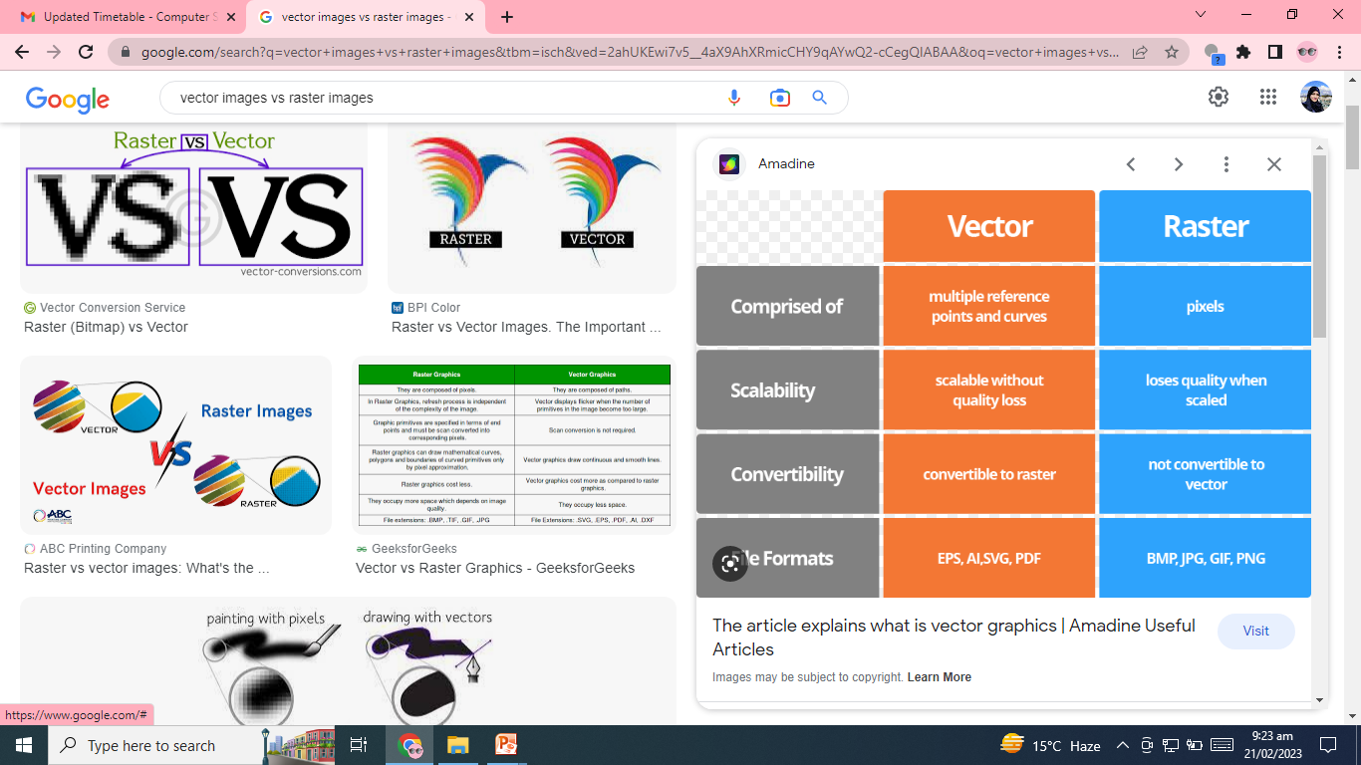

Slide 30
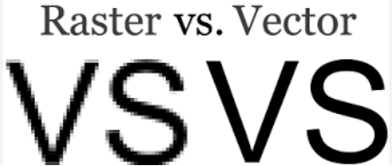

Slide 31
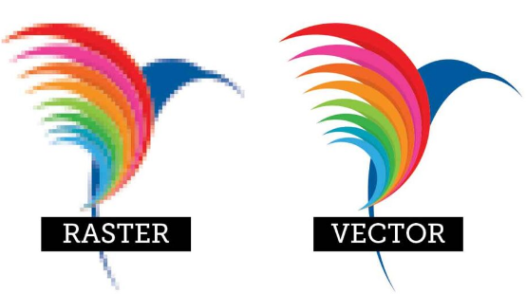

Slide 32
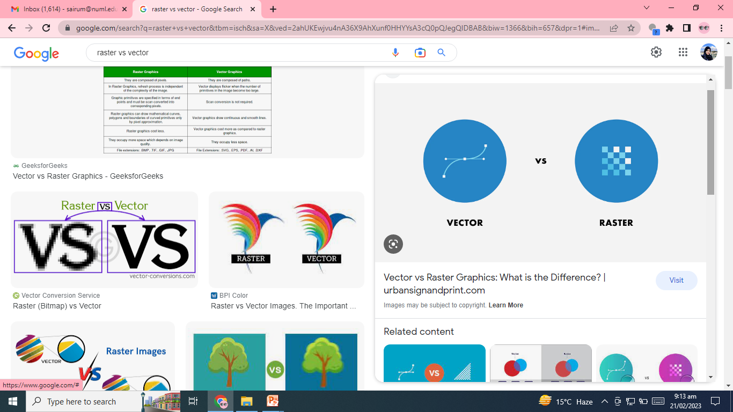

Slide 33
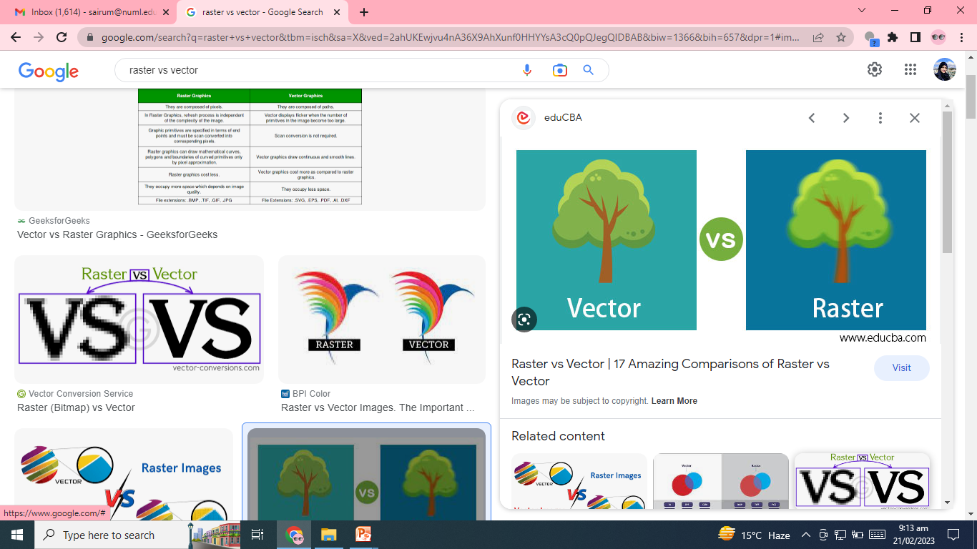

Slide 34
Define How does the choice between raster and vector images impact printing quality?
Raster images, made of pixels, require high resolution for sharp prints but may pixelate when enlarged.
Vector images, defined by mathematical equations, maintain sharpness at any size, making them ideal for crisp prints,
while raster images suit detailed images like photographs but require careful resolution management.

Slide 35
Tools for creating and editing raster images and vector images
Raster Images:
Adobe Photoshop
GIMP (GNU Image Manipulation Program)
Corel PaintShop Pro
and Affinity Photo.
the tools for manipulating individual pixels and creating complex digital artworks or editing photographs.
Vector Images:
Adobe Illustrator
CorelDRAW
Inkscape
Affinity Designer.
This allows users to create and manipulate shapes, lines, and curves using mathematical equations, providing scalability without loss of quality and enabling precise control over design elements.

Slide 36
4 Major areas of Computer Graphics
Display of Information
Design and modeling (Represent Real world in a simpler more abstract form)
User Interface
Simulation.

Slide 37
Types of Graphics Systems
Active: The user interacts with the system using some input device like the mouse etc. eg Games, Flight Simulators etc
Passive: The user cannot interact with the system, eg TV

Slide 38

Computer graphics are present in almost every field of life these days.
Examples: Wireframe model of a sphere using the sweep representation.
This sphere can be rotated around its axis.
It is stored in the form of the intersection points.

Slide 39
Simple 3d objects:
A shaded pyramid.
Simple 3d Shaded Objects (Sweep Representation or wireframe)
Primitive 3d objects shaded with textures

Slide 40
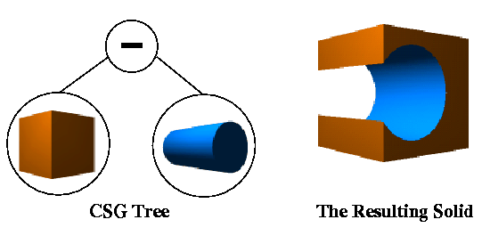
CSG
Create a hole with the help of CSG or constructive solid geometry:
First create a cube and then pass a cylinder through it. Then you take out the cylinder i.e. we subtract the object.

Slide 41
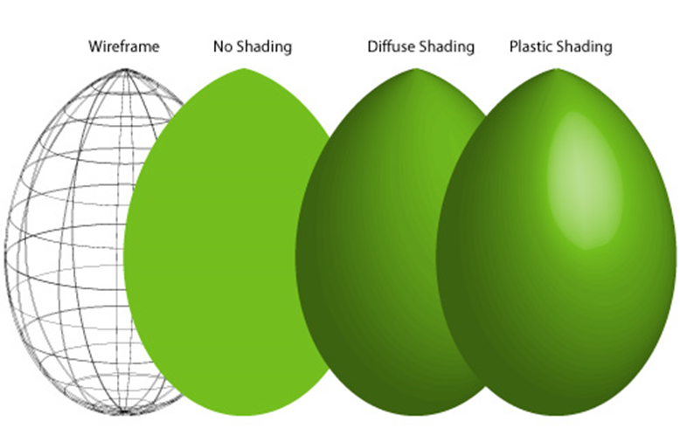
Shading effects, Texture mapping and shadows. Sometimes using a texture is better than using the normal shading.

Slide 42
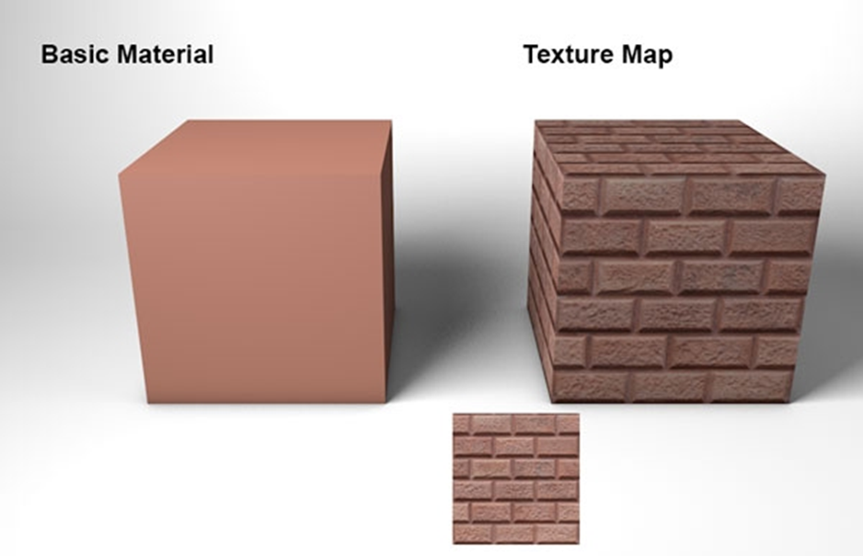
Texture Image mapping, textures are used to add depth to the image so the user can perceive the depths better.

Slide 43
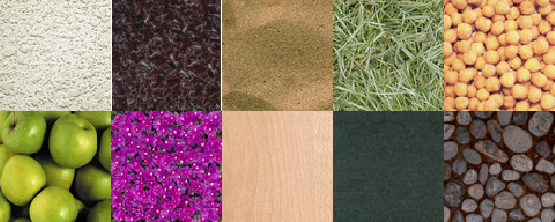
Stochastic Textures (Real world Textures), they are random so they are difficult to create using the computer. Visual Realism: Trying to create the visual effect of real world.

Slide 45
Standards graphics packages
GKS: Graphics Kernel System: First standard by ISO and OSI, Introduced in 1977.
SRGP: Simple Raster graphics Package
PHIGS: Programmer Hierarchical Interactive Graphics System (till late 90).
An (API) standard for rendering 3D computer graphics, considered to be the 3D graphics standard for the 1980s through the early 1990s.
Subsequently, a combination of features and power led to the rise of OpenGL, which became the most popular professional 3D API of the mid to late 1990s.

Slide 46
Open GL:
Current standard, quiet Popular, available on Windows and LINUX, device independent
Most languages or compilers have their own built in graphics libraries and APIs or support for 2d and 3d Graphics.
Open Graphics Library (OpenGL) is:
a cross-language, cross-platform application programming interface (API) for rendering 2D and 3D vector graphics.
The API is typically used to interact with a graphics processing unit (GPU), to achieve hardware-accelerated rendering.
Device independent: OpenGL, X11
Device Dependent: SOLARIS, HP-AGP Applications built using these systems could not run on any other device but the one they supported (hardware device).

